Slide 1
Y-1493
30 Best Business Ideas for Small Scale Business In India With Investment Of 1.50 Crore (Plant And Machinery).
Start Your Own Industry.
www.entrepreneurindia.co

Slide 2
Introduction
A business idea is the response of a person or persons, or an organization to solving an identified problem or to meeting perceived needs in the environment (markets, community, etc). Finding a good idea is the first step in transforming the entrepreneur’s desire and creativity into a business opportunity. Every business comes out of an idea. Businesses are started by men and women who see that people want to buy a particular product or service. A good business idea is essential, or even a prerequisite, for a successful business venture.
www.entrepreneurindia.co

Slide 3
Niir Project Consultancy Services (NPCS) can provide Detailed Project Report on Required Project
www.entrepreneurindia.co

Slide 4
Furfural From Bagasse And Corncobs
Furfural is produced from agricultural waste biomass that contain pentosans, which are aldose to sugars, composed of small rings formed from short five-member chains, that constitute a class of complex carbohydrates, present in cellulose of many woody plants such as corn cobs, sugar cane bagasse, rice, wheat bran, sawdust and oat hulls etc.
The global furfural market was valued at US$1.3 bn by 2013,US$450 million in 2014,$663.5 million in 2015 and In 2016, the market was valued USD 557.4 Million in terms of revenue. By Regions, 2017-2025” is expected to reach USD 1393.9 Million by 2025 in terms of revenue. In terms of volume, is estimated to reach by 464.5 Kiloton in 2016, $1,434.1 million by 2022 and expected to reach $1184.8 Kiloton by 2025.
www.entrepreneurindia.co

Slide 5
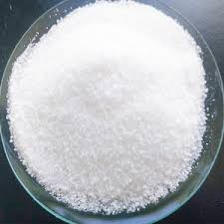
Zinc Chloride
Zinc chloride is the name of chemical compounds with the formula ZnCl2 and its hydrates. Zinc chlorides, of which nine crystalline forms are known, are colorless or white, and are highly soluble in water. ZnCl2 itself is hygroscopic and even deliquescent.
Demand for batteries in industrial and commercial applications is expected to rise similarly. The increasing consumer demand for batteries is forecast to match the demand for primary cells and dry cell batteries over the years. With advancements in technology, the demand for highly active advanced batteries is expected to rise. Zinc chloride batteries are considered as primary cell batteries and also used in dry cells. With growing consumption of battery grade zinc chloride in industrial applications, the zinc chloride market is estimated to grow significantly over the forecast period.
www.entrepreneurindia.co

Slide 6
Disposable Plastic Syringes
A syringe is a small, simple piston pump based medical instrument used to administer injections of intravenous drugs into the bloodstream, or to draw a blood sample from a patient. ... We have some models of disposable syringes with Lure lock tips as well as those without.
The overall market for syringes is expected to reach $15.99 billion by 2021 from $10.56 billion in 2016, at a CAGR of 8.7% during the forecast period. High prevalence of chronic diseases across the globe, rising geriatric population, increasing adoption of safety syringes, technological advancements, and increasing demand for vaccines are supporting the market growth of syringes. However, high cost of safety syringes and increasing incidence of needle stick injuries are the major challenges in Market.
www.entrepreneurindia.co

Slide 7
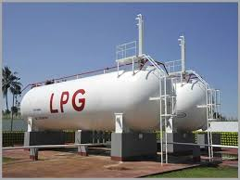
LPG Bottling Plant
Liquefied petroleum gas or liquid petroleum gas (LPG or LP gas), also referred to as simply propane or butane, are flammable mixtures of hydrocarbon gases used as fuel in heating appliances, cooking equipment, and vehicles.
Growth in the country’s LPG market over the past few years can be attributed to rising demand from residential and commercial segments in the country. Number of LPG consumers in India increased from 1387.3 million in FY13 to 2,041 million in FY16.
www.entrepreneurindia.co

Slide 8
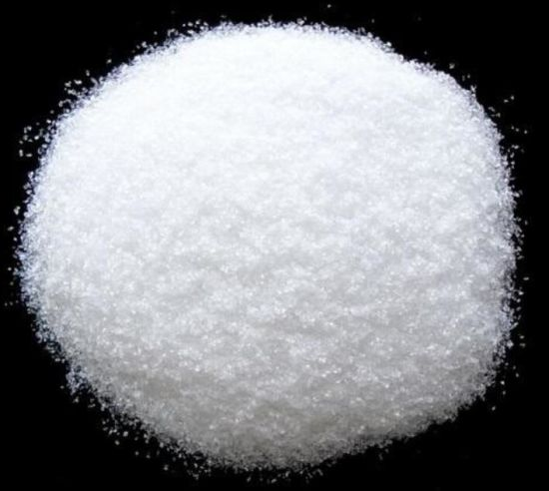
Magnesium Sulphate (Fertiliser Grade)
Ammonium Sulfate is a chemical compound crystalline in nature used primarily to manufacture artificial alkaline soil fertilizers for agriculture. Ammonium Sulfate is an inorganic water-soluble salt that contains: 21% Nitrogen. 24% Sulfur.
that the Global Magnesium Sulfate Market is set to register an above-average CAGR of 5.50% from 2018 to 2024. The market has is expected to reach a valuation in excess of USD 1,334.6 Mn by the end of the forecast period.
www.entrepreneurindia.co

Slide 9
Work Wear, Uniform Clothing For Factory
(Trousers & High Visibility Long Sleeves Jackets)
Work wear is clothing worn for work, especially work that involves manual labor. Often those employed within trade industries elect to be outfitted in work wear because it is built to provide durability and safety. The work wear clothing industry is growing and consumers have numerous retailers to choose from. Chains that have made a commitment to the $1 billion and rising work wear business report steady 6 percent to 8 percent annual gains in men's work wear. Global work wear/uniform market is expected to grow at a significant CAGR in the upcoming period as the scope and its applications are rising enormously across the globe. Work wear/uniform clothing should be fashionable and high performance. The factors that are playing a major role in the growth of work wear/uniform industry are the growth in fabric and material innovation, the growing number of labor expanding the user base, the growth in female workers, and the developing enterprise and business sector.
www.entrepreneurindia.co

Slide 10
Virgin Coconut Oil
Virgin Coconut Oil provides a direct source of energy and isn't stored as fat in the body. Many of the benefits associated with Virgin Coconut Oil are thanks to its high lauric acid content( the main active constituent found in mothers milk).This also makes it have antiviral, antibacterial and antifungal properties.
he global virgin coconut oil market stood at $ 2.7 billion in 2018 and is projected to grow at a CAGR of over 9% during the forecast period to reach $ 4.7 billion by 2024, on the back of increasing investments in the industry.
www.entrepreneurindia.co

Slide 11
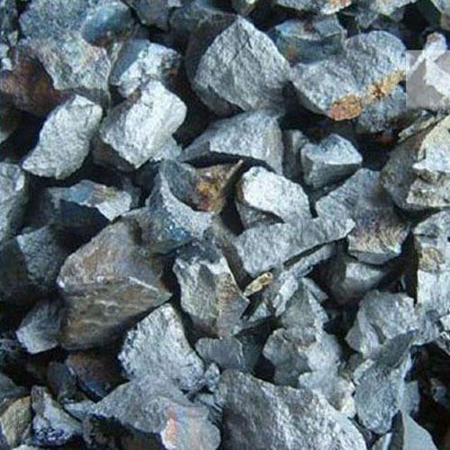
Ferro Molybdenum
Ferro Molybdenum is an alloy which is formed by combining iron and Molybdenum. Ferro Molybdenum is a hardening agent and is found in many alloy steels that are heat-treatable. Molybdenum prevents corrosion in stainless steels, and when mixed with iron, the Molybdenum also strengthens and hardens into austenite.
The global market size is estimated to grow at CAGR above 7.2 % over the forecast time frame 2019 to 2026 and reach the market value around USD 65 billion by 2026.
www.entrepreneurindia.co

Slide 12
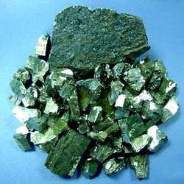
Ferro Vanadium
Ferro Vanadium is a universal hardener, strengthener and anti-corrosive additive for steels like high-strength low-alloy (HSLA) steel, tool steels, as well as other ferrous-based products. Ferro Vanadium was first used in the production of the Ford Model T and is still used in the automobile industry today.
The global market is expected to showcase a significant CAGR of 4.8% during the forecasted period 2018-2027. Additionally, the global Ferro Vanadium market is thriving on the back of hardened steel application in the manufacturing of bicycles frames, axles, crankshafts and other highly critical steel components. Thus, the rapidly expanding steel industry is anticipated to bolster the overall growth in the demand for the Ferrovanadium. In terms of regional platform, demand for Ferrovanadium in the Asia Pacific region is anticipated to propel the growth of overall global Ferrovanadium market over the forecast period.
www.entrepreneurindia.co

Slide 13
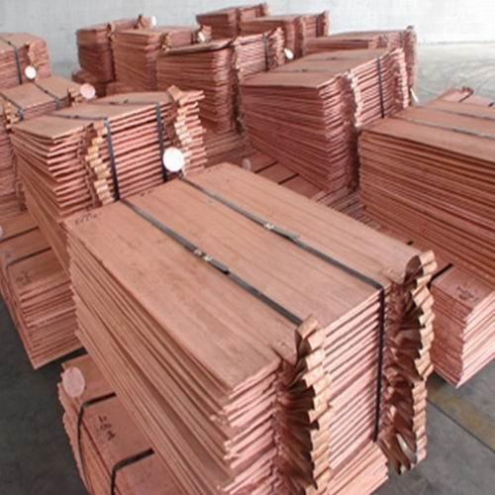
Copper Cathode From Copper Scrap
Copper extraction refers to the methods used to obtain copper from its ores. The conversion of copper consists of a series of physical and electrochemical processes. Methods have evolved and vary with country depending on the ore source, local environmental regulations, and other factors.
There is global copper supply demand factors at play. This is a complex market, and China plays an important role here. It is a given that China’s market is often in transparent. That’s why we consider this a directional indicator.
www.entrepreneurindia.co

Slide 14
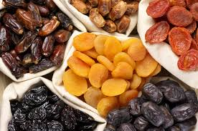
Dry Fruits Processing
(For Snack, Almond, Pistachio And Cashew Nut)
Dried fruits are one of the most popular products made by small-scale processors. Drying removes the water from foods so that the growth of micro-organisms is inhibited. It also reduces the weight and bulk of foods which cuts down on transport and storage costs. Sun drying is the simplest and cheapest method of drying.
The global fruit & vegetable processing market was valued at USD 230.96 Billion in 2016 and is projected to grow at a CAGR of 7.1% from 2017, to reach USD 346.05 Billion by 2022. The global fruit and vegetable processing market comprises the global fruit & vegetable processing equipment market and processed fruits & vegetables market.
www.entrepreneurindia.co

Slide 15
UPVC Profiles For Doors And Windows
UPVC is the general abbreviation for un-plasticized poly vinyl chloride. This works as a very useful material used widely for doors, windows and pipelines these days. One of the major advantages is the uPVC Windows and uPVC Doors are stronger than the old and traditional wooden doors and windows.
The doors market is estimated to be valued at USD 81.67 Billion in 2017 and is projected to reach USD 103.52 Billion by 2022, at a CAGR of 4.86% from 2017. The base year considered for the study is 2016 and the forecast period is from 2017 to 2022.
www.entrepreneurindia.co

Slide 16
Curcumin Extraction Unit
Curcumin is a bright yellow chemical produced by Curcuma longa plants. It is the principal curcuminoid of turmeric (Curcuma longa), a member of the ginger family, Zingiberaceae. It is sold as an herbal supplement, cosmetics ingredient, food flavoring, and food coloring.
Rising awareness among the consumers towards adverse impact of synthetic food colors and increasing acceptance of Ayurveda and Herbal medicines world over are proving to be the growth drivers for global curcumin market. The global curcumin market is expected to grow from USD 56.23 million in 2017 to USD 114.34 million by 2025 at a CAGR of 9.28% during the forecast period 2018-2025, according to the new report published by Fior Markets.
www.entrepreneurindia.co

Slide 17
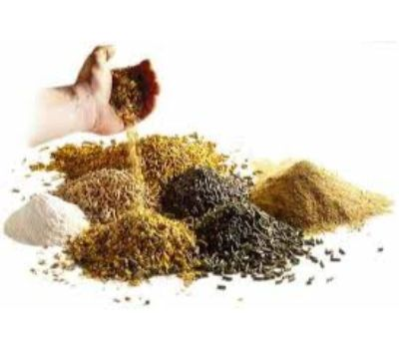
Pre-mix And Animal Feed (Poultry And Cattle)
It is a value added solution for feeds with sustainable safety and quality. Manufacturing a Quality Premix by Avitech A premix is a mixture of vitamins, trace minerals, medicaments, feed supplements and diluents. Compound feed is fodder that is blended from various raw materials and additives. These blends are formulated according to the specific requirements of the target animal. They are manufactured by feed compounders as meal type, pellets or crumbles.
The global Feed Premix Market is expected to gain impetus from the rising demand for balanced feed products, including micronutrients and macronutrients. This information is published in a report by Fortune Business Insights, titled, and Regional Forecast, 2019-2026.
www.entrepreneurindia.co

Slide 18
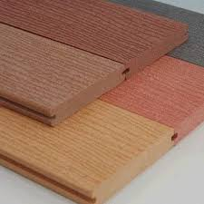
Wood Plastic Composite (WPC)
Plastic lumber (PL) is a plastic form of lumber (timber) made of virgin or recycled plastic (in which case it can be called RPL). It is made of 100% plastic, compared with wood-plastic composite lumber. Widely employed in outdoor decking, it is also used for molding and trim and garden furniture such as park benches.
Global Wood Plastic Composite Market is projected to reach USD 6.12 Billion by 2023, at a CAGR of over 12% from 2018 to 2023 owing to the increasing demand from the building & construction application and rising trend of urbanization. Based on type, the wood-plastic grow at the highest CAGR during the forecast period owing to growing economies and increasing construction activities.
www.entrepreneurindia.co

Slide 19
Protein Bar
Protein bars are nutrition bars that contain a high proportion of protein to carbohydrates/fats. Protein bars are targeted to people who primarily want a convenient source of protein that doesn't require preparation (unless homemade). There are different kinds of food bars to fill different purposes
India's energy bar market is forecasted to grow at a CAGR of around 5% during the forecasted period (2019-2024). Consumer demand for convenient and healthy on-the-go snack options has by-far been the primary attribute for sales of energy bars in the country. Increasing sports participation and the increasing gym-going population are expected to further propel the growth of energy bars.
www.entrepreneurindia.co

Slide 20
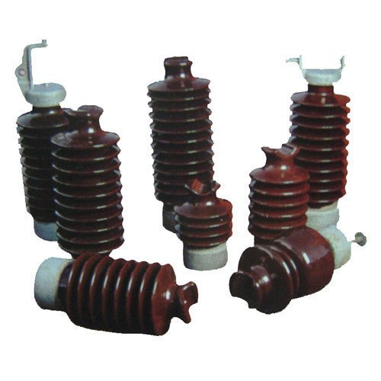
Porcelain Insulator
Porcelain is the most frequently used material for insulators. Insulators are made of wet, processed porcelain. The shells are dried and dipped into a glaze material. After glazing, the shells are fired in a kiln at about 1200 8C. The glaze improves the mechanical strength and provides a smooth, shiny surface
The market for electric insulator is expected to grow at a CAGR of approximately 7.81% during the forecast period of 2020 – 2025. With rapid integration of renewables and distributed technologies onto the grid, utilities are increasingly upgrading their existing infrastructure. The development of renewable-based power generation is expected to result in the expansion of T&D infrastructure, resulting an increase in demand for electric insulators over the coming years.
www.entrepreneurindia.co

Slide 21
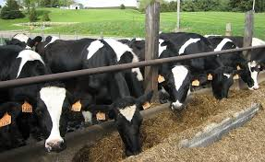
Cattle Farming
Cattle farm - farm consisting of a large tract of land along with facilities needed to raise livestock (especially cattle) cattle ranch, ranch, spread. Farm - workplace consisting of farm buildings and cultivated land as a unit it takes several people to work the farm Based on Word Net 3.0, Farlex clipart collection.
The Indian animal husbandry market was worth INR 3,892 Billion in 2018. Animal husbandry deals with the agricultural practice of breeding and raising livestock. Products obtained from animal husbandry include broiler meat, eggs, buffalo meat, sheep/goat meat, pig meat, wool, animal skin, etc. Looking forward, the market to reach INR 7,600 Billion by 2024, exhibiting a CAGR of 11.8% during 2019-2024.
www.entrepreneurindia.co

Slide 22
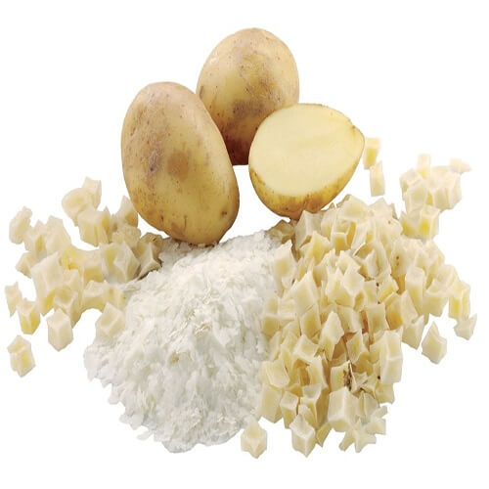
Potato Flakes And Pellets
Potato flakes are the most important form of dehydrated potato products, which also include potato granules, pellets, powder, shredded and sliced potato. Dehydrated potato flakes are made by pressing cooked mashed potatoes onto a drum drier, which forms a sheet that can be broken up and ground to the required density.
The production of potato flakes has huge potentials in the fast growing Indian market. Potato Flake is being increasingly consumed by manufacturers of snack food, soup powder, bread, biscuit and other bakery products. The global potato chips market is expected to grow at a CAGR of 4.3%, during the period 2017-2022, to reach a market value of USD 40.3 billion by 2022.
www.entrepreneurindia.co

Slide 23
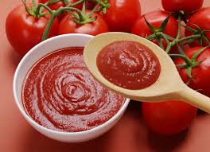
Tomato Puree And Fruit Concentrate
With Hot Break Process
Tomato purée is a thick liquid made by cooking and straining tomatoes. The difference between tomato paste, tomato purée, and tomato sauce is consistency; tomato puree has a thicker consistency and a deeper flavor than sauce.
The India Tomato Puree market is currently experiencing strong growth. India is the world’s second largest tomato producer after China and currently accounts for 11% of the total global tomato production. The majority of the tomatoes produced in the country are consumed fresh with the remaining being processed into products such as tomato paste, tomato juice, tomato sauce, tomato ketchup, etc.
www.entrepreneurindia.co

Slide 24
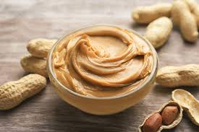
Peanut Butter
Peanut butter is a brown paste made out of crushed peanuts which you can spread on bread and eat.
Revenue in the Peanut Butter segment amounts to US$0.2m in 2019. The market is expected to grow annually by -23% (CAGR 2019-2023). Peanut butter is a high protein, low calorie product that possess high nutritional value. It is healthy alternative to dairy butter and used as bread spread. Major market presence of peanut butter is in western countries in comparison to Asian countries such as India as product is relatively new to the Asian region. Peanut butter is used in various applications in the form of spread and is used as the substitute for milk butter.
www.entrepreneurindia.co

Slide 25
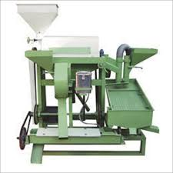
Dal Mill (Pulse)
This mini dal mill is simple in construction and easy to operate and maintains. It has been developed for de husking and splitting of food legumes viz. Pigeon pea gram and black gram. It consists of horizontal tapered roller the roller is covered with emery coating surrounded by screen through which husk powder is discharged.
The dal milling industry in India is one of the major agro processing industries in the country. From an annual production of 13.19 million tonnes of pulse in the country, 75% of these pulses are processed by dal mills. Thus, due to demand it is a good project for entrepreneurs to invest.
www.entrepreneurindia.co

Slide 26
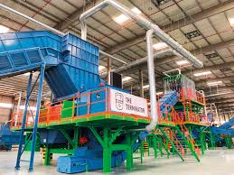
E-Waste Recycling Plant
E-waste is a popular, informal name for electronic products nearing the end of their useful life. Computers, televisions, VCRs, stereos, copiers, and fax machines are common electronic products. Many of these products can be reused, refurbished, or recycled
The total e-waste generated globally that stood at 5.8 kg per inhabitant in 2014 increased to 6.3 kg per inhabitant in 2017. The trend is expected to continue, generating around 7 kilograms of e-waste per inhabitant by 2022. Thus, imminent need to manage, recycle, and reuse electronic waste will drive market prospects during the forecast period from 2018 to 2026. In terms of metric tons the figure depicts the total e-waste generated worldwide in 2016 and forecast till 2021.
www.entrepreneurindia.co

Slide 27
Baby Wet Wipes And Facial Wet Tissues
There are a couple of types of wet wipes. Usually either for cleaning hands or baby wipes used to spot clean a baby when changing its diaper. The ones to clean your hands are also called moist towelettes a wet tissue is just a dry facial tissue that has been dampened.
The global care wipes market to grow at the rate of 5.4% during the forecast period 2018 to 2023. Globally, the market continues to witness new products launches from both key players and new market entrants. The facial personal care wipes market is stable in developed regions such as the US, since it already has a high per capita consumption and growing demand of private label products.
www.entrepreneurindia.co

Slide 28
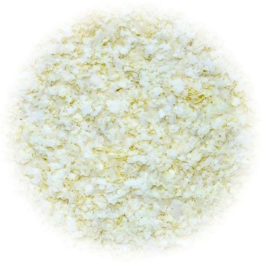
Potato Flakes
Potato flakes are flat chunks of dehydrated mashed potato. Although many of the potato cells are broken during production, the texture of the reconstituted product is kept firm by blanching, subsequent cooling, and the use of an additive, a monoglyceride emulsifier.
Global potato flake market is expected to witness a massive growth in the forecast period. Potato is a rich source of vitamin, iron, potassium and dietary fiber and on the other hand, potato flake was derived by dehydrating the potato, so that it can be used in numerous applications. The potato flakes are also used as a replacement for various flour such as corn flour, wheat flour etc. In a country such as India, potato flakes are used for various Indian delicacies like aloo bonda, fillings for samosa, etc. Because of the earthy flavor of potato flakes, they are also used in baked goods such as bread, cakes, muffins etc.
www.entrepreneurindia.co

Slide 29
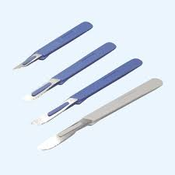
Surgical Blade & Disposable Scalpel
Surgical blades, or scalpels, are used for cutting skin and tissue during surgical procedures. There are different types of blades specific to the type of procedure. Surgical blades vary by size and shape. The number of the blade indicates the blade size and shape. Surgical blades are typically made with stainless steel or carbon steel.
The surgical scalpel market is estimated to account for US$ 759.4 Mn by the end of 2025, escalating at a CAGR of 3.5% during the forecast period from 2018 to 2025, rising from US$ 575.9 Mn in 2017. The growth of the surgical scalpel market can be attributed to the technological developments in the field of surgical scalpels and rise in the number of surgical procedures.
www.entrepreneurindia.co

Slide 30
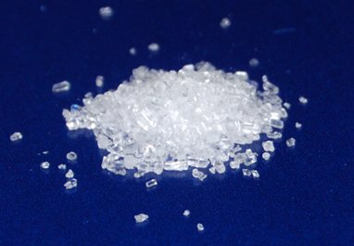
Zinc Sulphate
Zinc sulfate is an inorganic compound and dietary supplement. As a supplement it is used to treat zinc deficiency and to prevent the condition in those at high risk. Side effects of excess supplementation may include abdominal pain, vomiting, headache, and tiredness.
The Global overall and all-encompassing study of the "Zinc Sulfate Heptahydrate Market" with all its relevant factors that might have an influence on the growth of the market. This methodical quantitative and qualitative evaluation of the global Zinc Sulfate Heptahydrate market.
www.entrepreneurindia.co

Slide 31
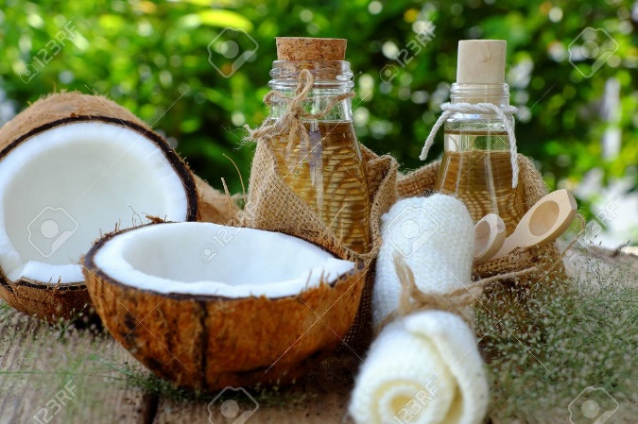
Coconut Oil From Copra
Coconut oil, or copra oil, is an edible oil extracted from the kernel or meat of mature coconuts harvested from the coconut palm (Cocos nucifera). Copra, dried sections of the meat of the coconut, the kernel of the fruit of the coconut palm (Cocos nucifera). Copra is valued for the coconut oil extracted from it and for the resulting residue, coconut-oil cake, which is used mostly for livestock feed
The coconut oil market is expected to start a downward consumption trend over the next seven years. The performance of the market is forecast to decrease slightly, with an anticipated CAGR of -1.3% for the seven-year period from 2018 to 2025, which is projected to depress the market volume to 3.2M tonnes by the end of 2025.
www.entrepreneurindia.co

Slide 32
Tags
#Furfural_From_Bagasse_&_Corncobs_Manufacturing_Plant, #(Pdf)_Production_Of_Furfural_From_Sugarcane, #Production_of_Furfural_from_Process, #Process_for_the_manufacture_of_furfural, #Zinc_Chloride_manufacturers, #Zinc_chloride_Production, #How_to_safely_make_zinc_chloride, #Disposable_Syringes_Manufacturers, #What_is_the_disposable_syringe_manufacturing_plant, #How_to_Start_Disposable_Syringes_Manufacturing_Business, #Disposable_Syringe_Manufacturing_Plant, Disposable Syringe Plant, LPG Bottling Plants, LPG Bottling Plants, LPG Bottling Plants - LPG Bottling Plant Manufacturer, Magnesium Sulphate - Manufacturing Plant, Detailed Project, Industrial Workwear Uniforms & Chef Pants, (PDF) Production of Activated Carbon from Industrial, Activated Carbon from Bamboo - Entrepreneur India, Bamboo Charcoal Products, project profile of virgin coconut oil, Process Design of Virgin Coconut Oil, Coconut Oil Manufacturing, Virgin Coconut Oil - Manufacturing Plant, Ferro Molybdenum Production Process, Ferro Molybdenum – Manufacturers, Ferro Vanadium – Manufacturers, Dry Fruits Processing, Dry Fruits Business Plan, Profitable Dry Fruits Processing Industry, Want to Start Dry fruits? UPVC Window Profile, UPVC Profiles Manufacturers, Upvc Profiles - Manufacturers, Suppliers, UPVC Profiles Manufacturers, Curcumin Extraction Unit,
www.entrepreneurindia.co

Slide 33
Curcumin Extraction Unit in Project Reports & Profiles, Curcumin Extraction Plant, Curcumin Extract Manufacturers, Cattle & Poultry Feed Manufacturing Business in Project, Setup a Cattle Feed Processing Plant: Business Plan, Animal Feed Production Business Plan, Business Plan: Setup a Poultry Feed Production Plant, Porcelain Insulator (lt & Ht) - Manufacturing Plant, Insulator - Manufacturing Plant, Detailed Project, Production of Insulators (HT & LT) – Entrepreneur, How to Start Small Businesses Processing Industry in India, What are the Most Successful Small Businesses? Which is the Best Profitable Business? Which is the Most Profitable Industry in India? Which Business is the Most Profitable in India? New Manufacturing Business Ideas, Extremely Profitable Manufacturing Business Ideas, Best List of Manufacturing Business Ideas, Most Profitable Business to Start in India, Start your own Industry, Starting a Business, Money Making Manufacturing Businesses, Most Profitable Manufacturing Business to Start in India, Moneymaking Startup Business Ideas, Lucrative Business Ideas, Greatest Business Ideas for Young Entrepreneurs, Small Business Ideas to Make Money, Fastest Growing Industries to Start a Business, Which Industry is Growing Fast? Which Industries are Booming? Best Industries for Starting a Business, Best Small Businesses Opportunities 2019, Industries for Hot Start-Ups, Growing Industries to Start a Business, Booming Industries, Biggest Growth Industries for Start-Ups, How to Start a Business, Starting your own Business, Industrial Manufacturing Business Ideas
www.entrepreneurindia.co

Slide 34
For more Projects and further details, visit at:
See more
https://bit.ly/2rsMlci
https://bit.ly/2NOmgM4
www.entrepreneurindia.co

Slide 35
Major Queries/Questions Answered in Our Report?
1. How has the industry performed so far and how will it perform in
the coming years?
What is the Project Feasibility of the Plant?
What are the requirements of Working Capital for setting up the
plant?
4. What is the structure of the industry and who are the key/major
players?
www.entrepreneurindia.co

Slide 36
5. What is the total project cost for setting up the plant?
What are the operating costs for setting up the plant?
What are the machinery and equipment requirements for setting
up the plant?
8. Who are the Suppliers and Manufacturers of Plant & Machinery for
setting up the plant?
9. What are the requirements of raw material for setting up the
plant?
www.entrepreneurindia.co

Slide 37
10. Who are the Suppliers and Manufacturers of Raw materials for
setting up the plant?
11. What is the Manufacturing Process of the plant?
12. What is the total size of land required for setting up the plant?
13. What will be the income and expenditures for the plant?
14. What are the Projected Balance Sheets of the plant?
www.entrepreneurindia.co

Slide 38
15. What are the requirement of utilities and overheads for setting up
the plant?
16. What is the Built up Area Requirement and cost for setting up the
plant?
17. What are the Personnel (Manpower) Requirements for setting up
the plant?
18. What are Statistics of Import & Export for the Industry?
19. What is the time required to break-even?
www.entrepreneurindia.co

Slide 39
20. What is the Break-Even Analysis of the plant?
21. What are the Project financials of the plant?
22. What are the Profitability Ratios of the plant?
23. What is the Sensitivity Analysis-Price/Volume of the plant?
24. What are the Projected Pay-Back Period and IRR of the plant?
25. What is the Process Flow Sheet Diagram of the plant?
26. What are the Market Opportunities for setting up the plant?
27. What is the Market Study and Assessment for setting up the plant?
28. What is the Plant Layout for setting up the plant?
www.entrepreneurindia.co

Slide 40
Reasons for Buying Our Report:
• The report helps you to identify a profitable project for investing or diversifying into by throwing light to crucial areas like industry size, market potential of the product and reasons for investing in the product
• The report provides vital information on the product like it’s characteristics and segmentation
• The report helps you market and place the product correctly by identifying the target customer group of the product
www.entrepreneurindia.co

Slide 41
• The report helps you understand the viability of the project by disclosing details like machinery required, project costs and snapshot of other project financials
• The report provides a glimpse of government regulations applicable on the industry
• The report provides forecasts of key parameters which helps to anticipate the industry performance and make sound business decisions
www.entrepreneurindia.co

Slide 42
Our Approach:
• Our research reports broadly cover Indian markets, present analysis, outlook and forecast for a period of five years.
• The market forecasts are developed on the basis of secondary research and are cross-validated through interactions with the industry players
• We use reliable sources of information and databases. And information from such sources is processed by us and included in the report
www.entrepreneurindia.co

Slide 43
Free Instant Online Project Identification and Selection Service
Our Team has simplified the process for you by providing a "Free Instant Online Project Identification & Selection" search facility to identify projects based on multiple search parameters related to project costs namely: Plant & Machinery Cost, Total Capital Investment, Cost of the project, Rate of Return% (ROR) and Break Even Point % (BEP). You can sort the projects on the basis of mentioned pointers and identify a suitable project matching your investment requisites……Read more
www.entrepreneurindia.co

Slide 44
Download Complete List of Project Reports:
Detailed Project Reports
NPCS is manned by engineers, planners, specialists, financial experts, economic analysts and design specialists with extensive experience in the related industries.
Our Market Survey cum Detailed Techno Economic Feasibility Report provides an insight of market in India. The report assesses the market sizing and growth of the Industry. While expanding a current business or while venturing into new business, entrepreneurs are often faced with the dilemma of zeroing in on a suitable product/line.
www.entrepreneurindia.co

Slide 45
And before diversifying/venturing into any product, they wish to study the following aspects of the identified product:
Good Present/Future Demand
Export-Import Market Potential
Raw Material & Manpower Availability
Project Costs and Payback Period
The detailed project report covers all aspect of business, from analyzing the market, confirming availability of various necessities such as Manufacturing Plant, Detailed Project Report, Profile, Business Plan, Industry Trends, Market Research, Survey, Manufacturing Process, Machinery, Raw Materials, Feasibility Study, Investment Opportunities, Cost and Revenue, Plant Economics, Production Schedule,
www.entrepreneurindia.co

Slide 46
Working Capital Requirement, uses and applications, Plant Layout, Project Financials, Process Flow Sheet, Cost of Project, Projected Balance Sheets, Profitability Ratios, Break Even Analysis. The DPR (Detailed Project Report) is formulated by highly accomplished and experienced consultants and the market research and analysis are supported by a panel of experts and digitalized data bank.
We at NPCS, through our reliable expertise in the project consultancy and market research field, have demystified the situation by putting forward the emerging business opportunity in India along with its business prospects……Read more
www.entrepreneurindia.co

Slide 47
Visit us at:
www.entrepreneurindia.co
www.niir.org
www.entrepreneurindia.co

Slide 48
Take a look at
NIIR PROJECT CONSULTANCY SERVICES
on #Street View
https://goo.gl/VstWkd
www.entrepreneurindia.co

Slide 49
Locate us on
Google Maps
https://goo.gl/maps/BKkUtq9gevT2
www.entrepreneurindia.co

Slide 50
Contact us
NIIR PROJECT CONSULTANCY SERVICES
106-E, Kamla Nagar, Opp. Spark Mall,
New Delhi-110007, India.
Email: npcs.ei@gmail.com , info@entrepreneurindia.co
Tel: +91-11-23843955, 23845654, 23845886, 8800733955
Mobile: +91-9811043595Fax: +91-11-23841561
Website : www.entrepreneurindia.co , www.niir.org
Take a look at NIIR PROJECT CONSULTANCY SERVICES on #StreetView
https://goo.gl/VstWkd
www.entrepreneurindia.co

Slide 51
An ISO 9001:2015 Company
www.entrepreneurindia.co

Slide 52
Who are We?
One of the leading reliable names in industrial world for providing the most comprehensive technical consulting services
We adopt a systematic approach to provide the strong fundamental support needed for the effective delivery of services to our Clients’ in India & abroad
www.entrepreneurindia.co

Slide 53
What do We Offer?
Project Identification
Detailed Project Reports/Pre-feasibility Reports
Business Plan
Market Research Reports
Technology Books and Directory
Industry Trend
Databases on CD-ROM
Laboratory Testing Services
Turnkey Project Consultancy/Solutions
Entrepreneur India (An Industrial Monthly Journal)
www.entrepreneurindia.co

Slide 54
How are We Different ?
We have two decades long experience in project consultancy and market research field
We empower our customers with the prerequisite know-how to take sound business decisions
We help catalyze business growth by providing distinctive and profound market analysis
We serve a wide array of customers , from individual entrepreneurs to Corporations and Foreign Investors
We use authentic & reliable sources to ensure business precision
www.entrepreneurindia.co

Slide 55
Our Approach
Requirement collection
Thorough analysis of the project
Economic feasibility study of the Project
Market potential survey/research
Report Compilation
www.entrepreneurindia.co

Slide 56
Contact us
NIIR PROJECT CONSULTANCY SERVICES
106-E, Kamla Nagar, Opp. Spark Mall,
New Delhi-110007, India.
Email: npcs.ei@gmail.com , info@entrepreneurindia.co
Tel: +91-11-23843955, 23845654, 23845886, 8800733955
Mobile: +91-9811043595
Website : www.entrepreneurindia.co , www.niir.org
Take a look at NIIR PROJECT CONSULTANCY SERVICES on #StreetView
https://goo.gl/VstWkd
www.entrepreneurindia.co

Slide 57
Follow Us
https://www.linkedin.com/company/niir-project-consultancy-services
https://www.facebook.com/NIIR.ORG
https://www.youtube.com/user/NIIRproject
https://plus.google.com/+EntrepreneurIndiaNewDelhi
https://twitter.com/npcs_in
https://www.pinterest.com/npcsindia/
www.entrepreneurindia.co

Slide 58
For more information, visit us at: www.entrepreneurindia.co www.niir.org
www.entrepreneurindia.co

